Slide 1

Growth
Mindset

Slide 2
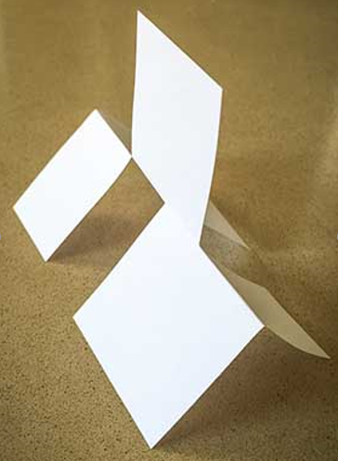
Paper Challenge
Look, but don’t touch, at the model from all sides.
Recreate the model with your piece of paper and scissors.

Slide 3
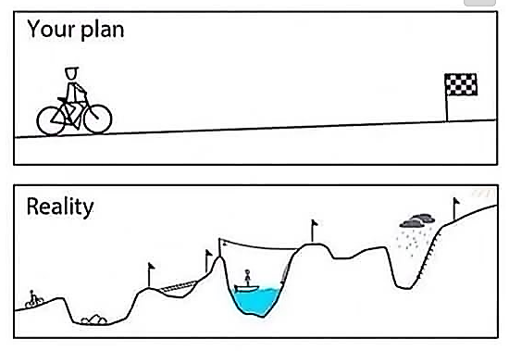

Slide 4
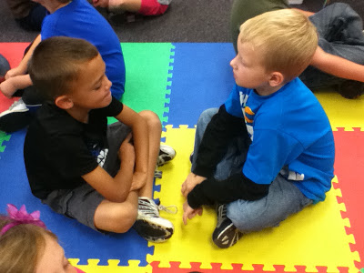
Discuss the Challenge
How did this activity make you feel?
What were you thinking as you did this activity?

Slide 5
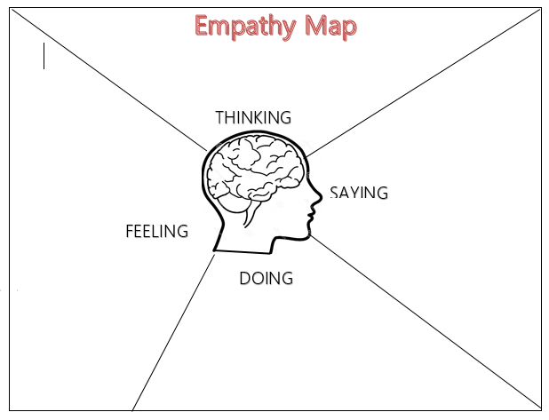

The Most Magnificent Thing
As we read the story, fill in Empathy Map

Slide 6


Slide 7
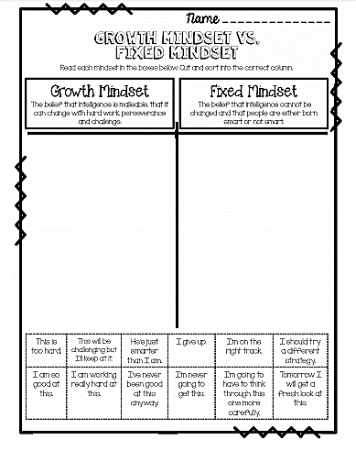
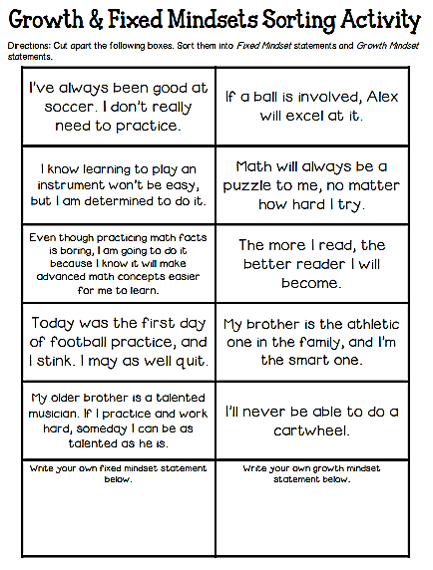
Growth Mindset Sort

Slide 8
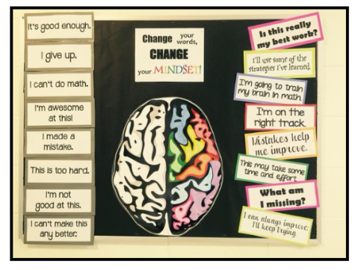
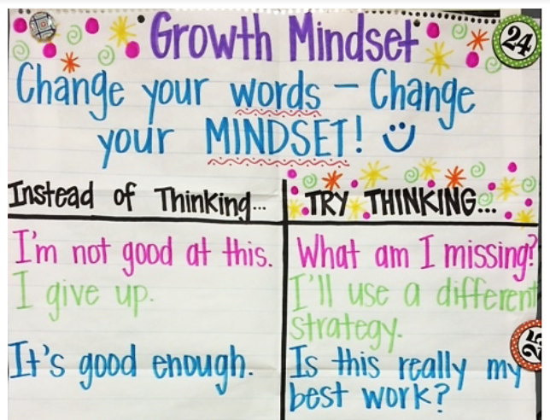
Co-Construct Growth Mindset Language
With your students, change the language from a fixed mindset to a growth mindset.

Slide 9

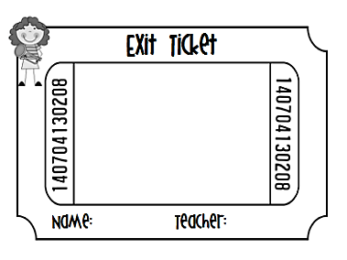
Reflect
What could we have said differently?
Choose one phrase from the board (language recorded during paper activity) and change the phrase into growth mindset language.

