Slide 1
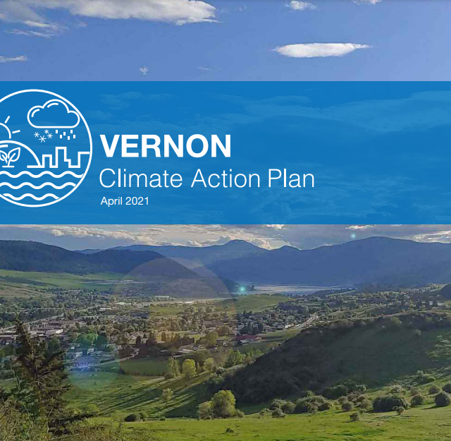
Vernon’s Climate Action Plan
February 15, 2022

Slide 2
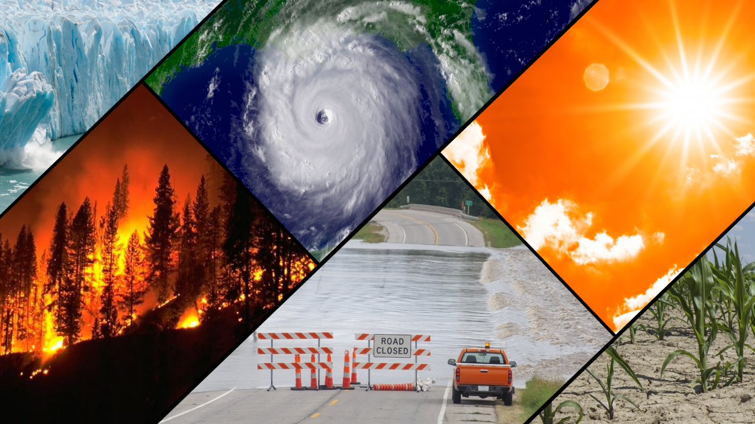
How has Vernon’s climate been changing?

Slide 3
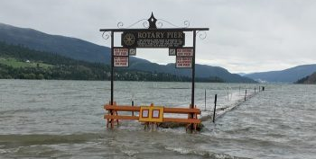

Slide 4
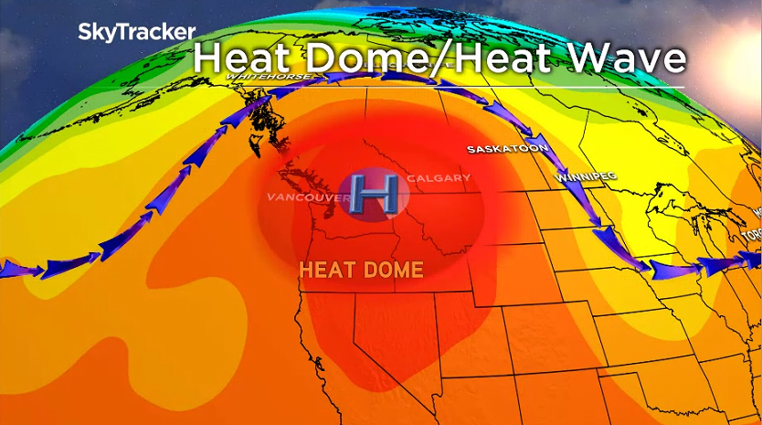

Slide 5
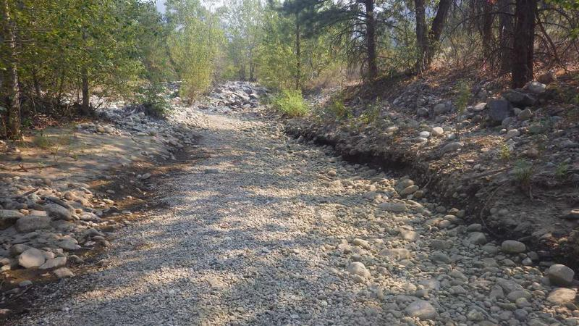

Slide 6
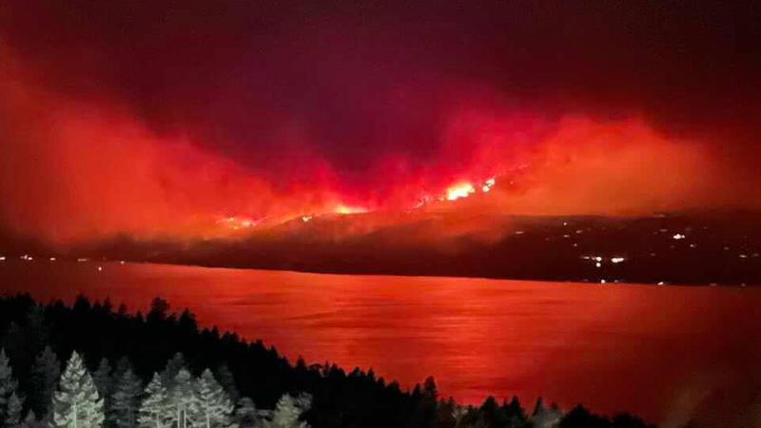

Slide 7
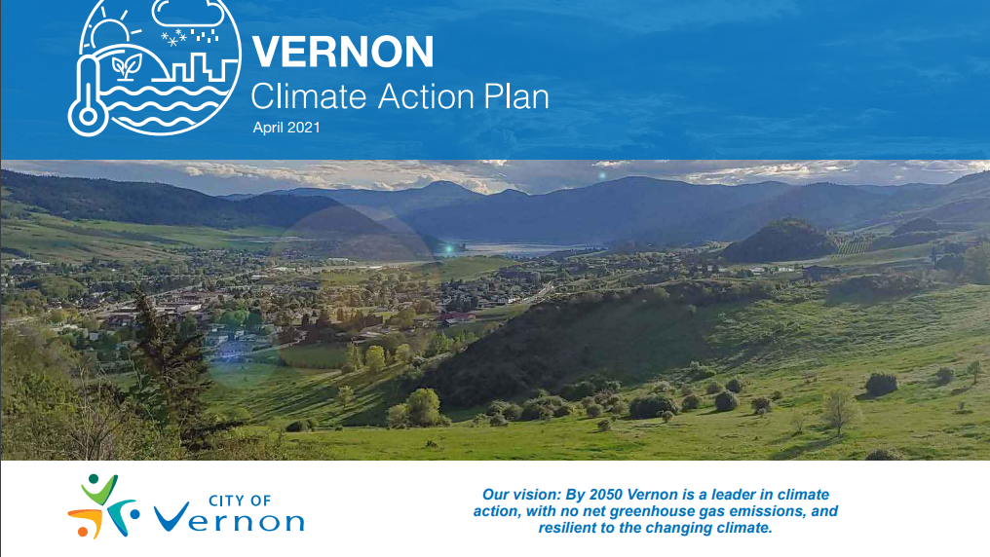
How has Vernon responded?

Slide 8
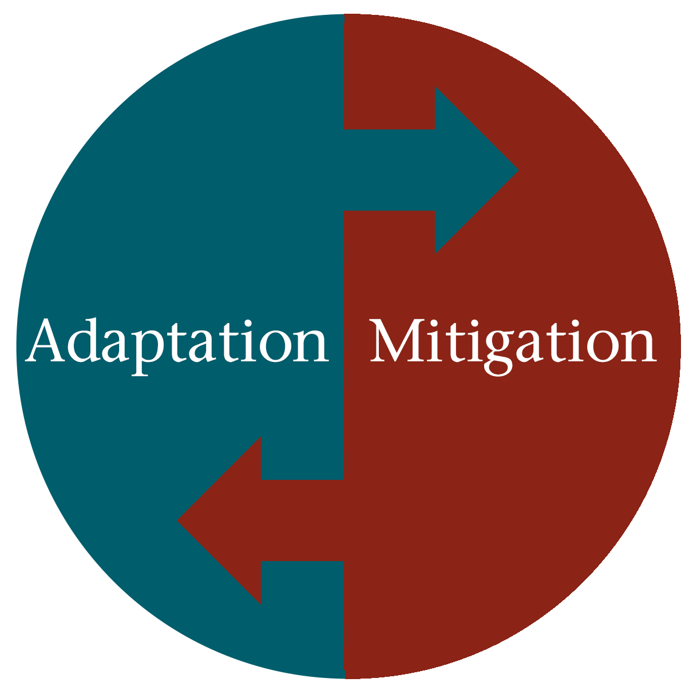

Slide 9
ADAPTATION
The process of adjustment to actual or expected climate and its effects. In human systems, adaptation seeks to minimize or reduce harm or exploit beneficial opportunities. In natural systems, human intervention may facilitate adjustment to expected climate impacts.

Slide 10
A human intervention to reduce amount of greenhouse gases in our atmosphere.
Mitigation

Slide 11
Resilience
The ability of systems and communities to absorb the impacts of climate change and maintain an acceptable level of functionality and service.
⭐Adaptation + Mitigation=Resilience

Slide 12
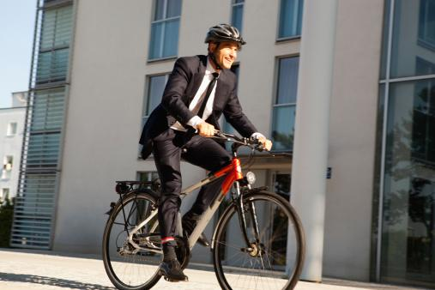

Slide 13
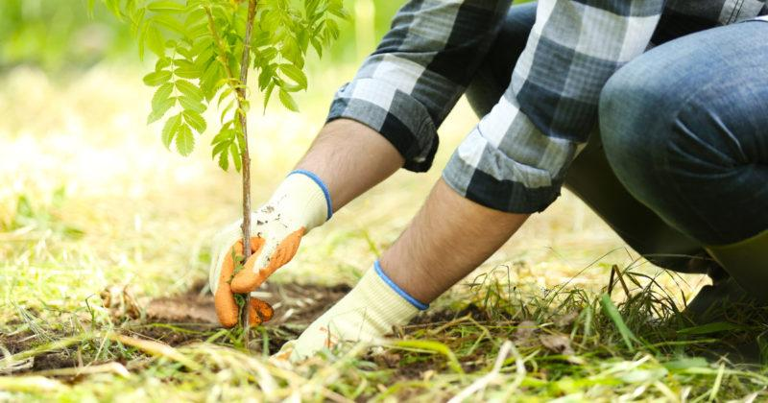

Slide 14
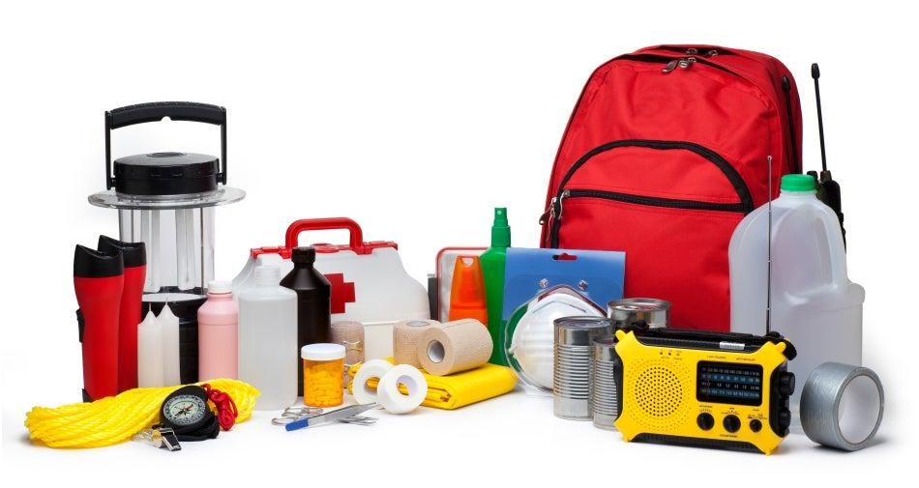

Slide 15
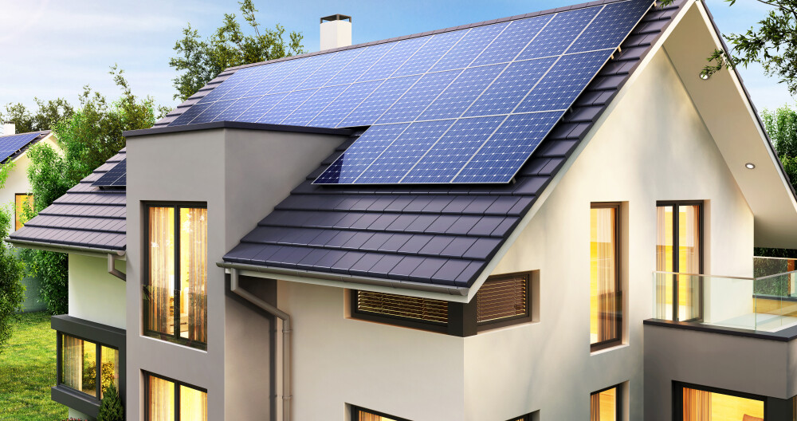

Slide 16
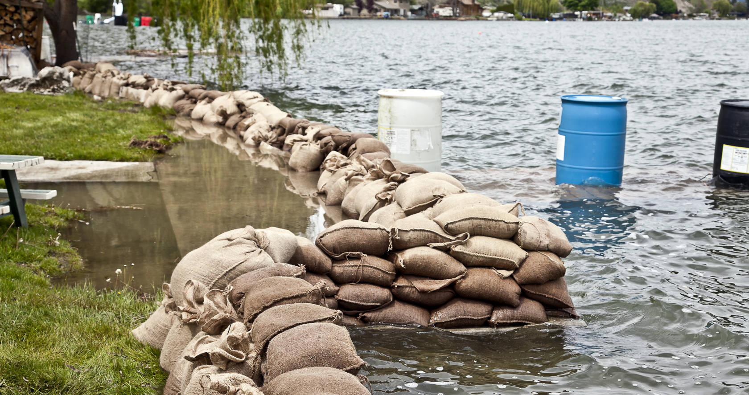

Slide 17
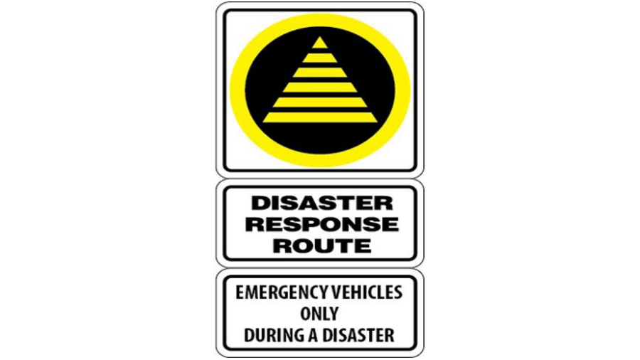

Slide 18
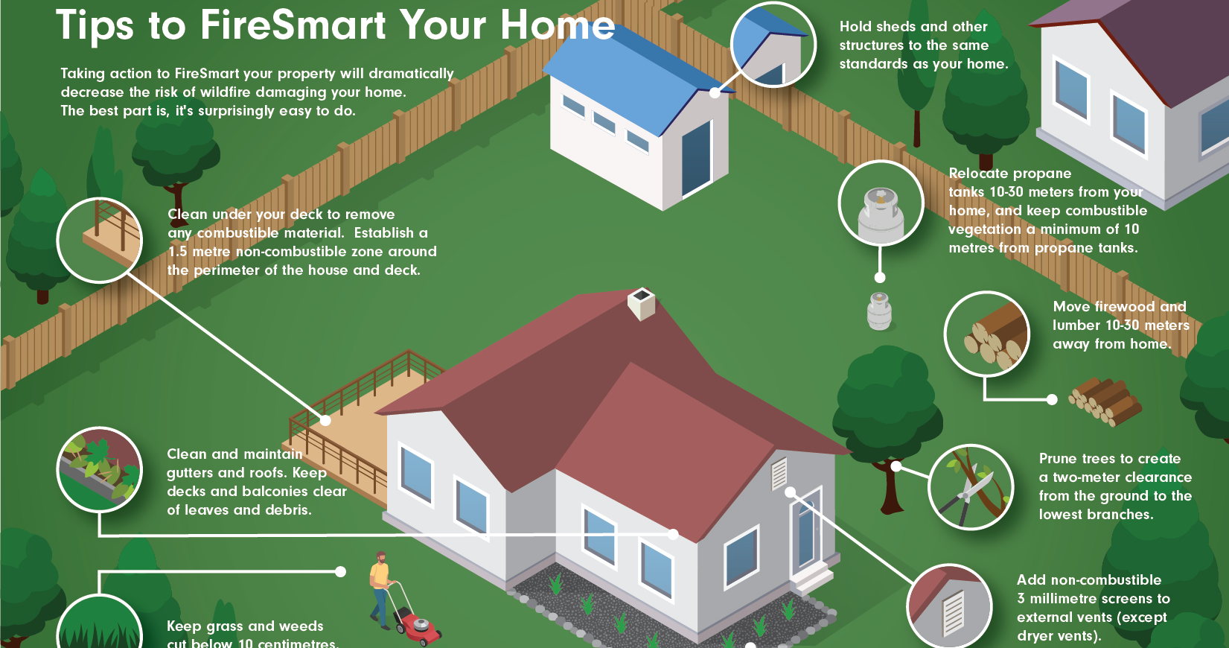

Slide 19
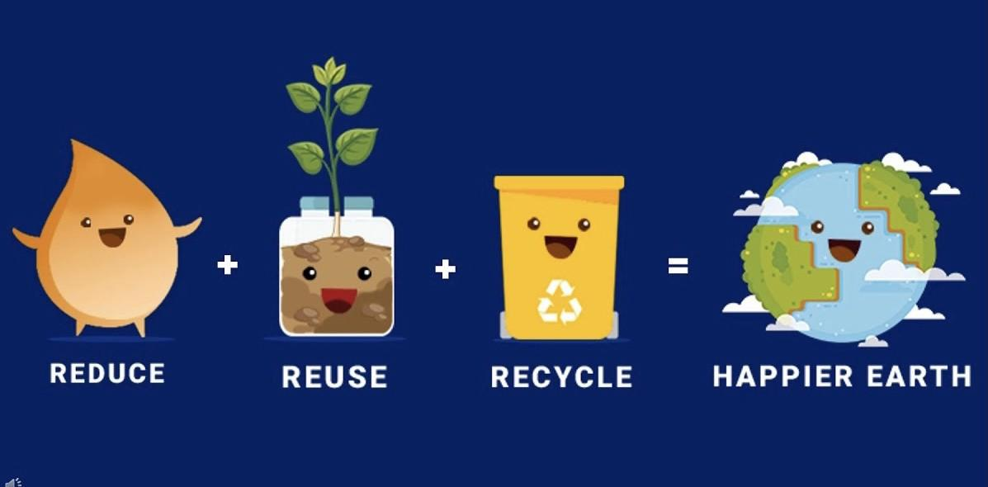

Slide 20
Next class
1st Block: Mini project presentations
2nd Block: CAP 8 Focus areas
Vernon’s vision

