Slide 1

Game Changers
Positively Impacting Climate

Slide 2
In current news…
https://globalnews.ca/video/rd/958716483708/

Slide 3
It is now more important than ever, to do what we can on an individual basis to have a positive impact on Climate Change…

Slide 4
Examples of beginning steps
https://globalnews.ca/video/rd/1182776899519/

Slide 5
So what are some of the big game changers today and how can they help us positively impact climate change?

Slide 6
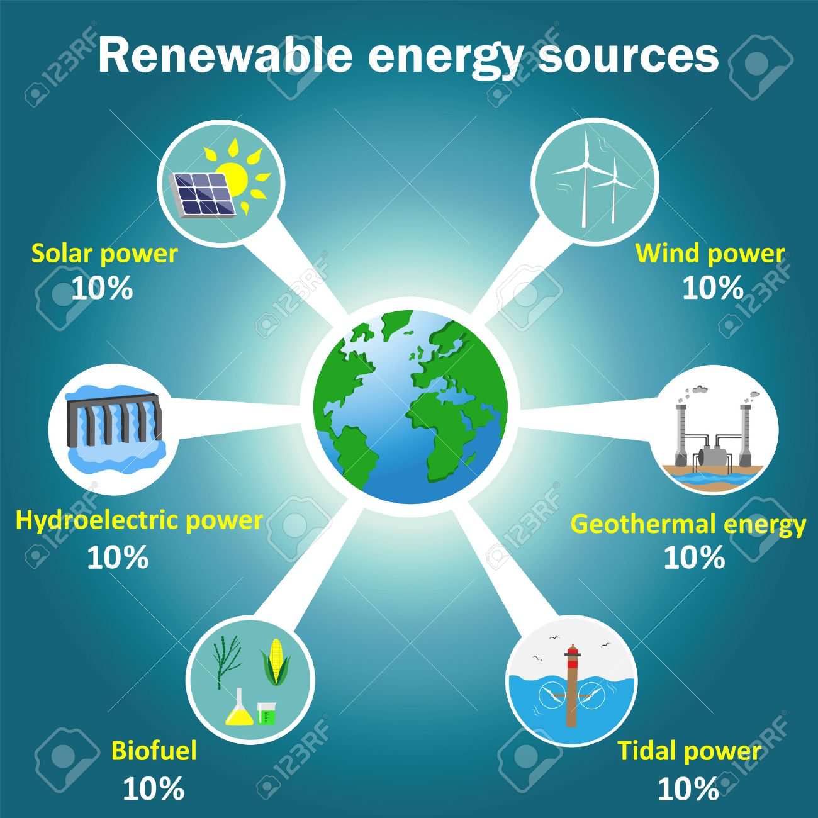
Alternative Energy
Solar
Geothermal
Biofuel
Wind

Slide 7
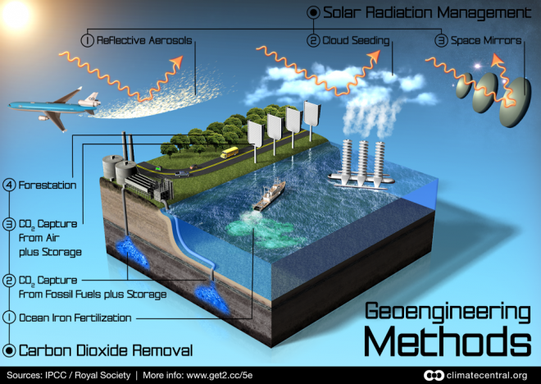
Geoengineering
Advances in Science and Technology
Examples
  Solar radiation
  management
  Carbon dioxide
  removal

Slide 8
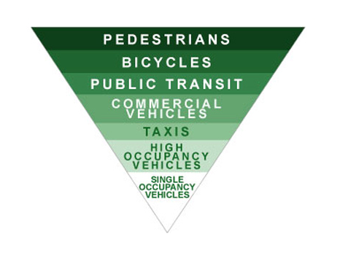
Green Transportation
Hybrid vehicles
Electric cars
Car sharing/carpooling
Public transit
Electric bikes
Airplanes

Slide 9
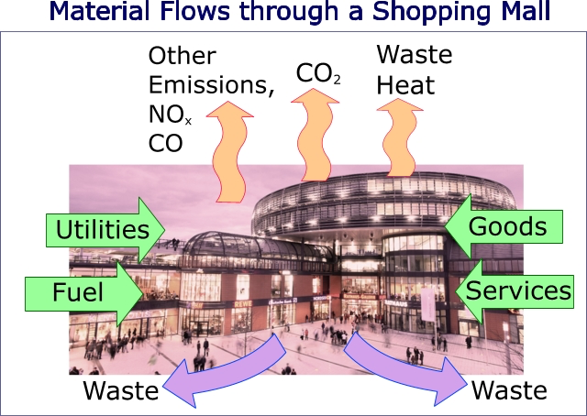
Changing Habits
Diet
  Buy local
  Organic
  Vegan
Daily life
  Water usage
  Clothing
  Recycling

Slide 10
Part 2 of this project involves thinking about how Human Impact on Climate can be reduced…

